Slide 1
Tutorial 9: Kraken
Kevin Hang and Maitland Witmer

Slide 2
What is Kraken?
An ultrafast and highly accurate program to assign taxonomic labels to sequences.
Finds an exact match in the database of k-mers rather than in-exact alignments for speed gains.
Maintains both high sensitivity and precision at much faster computation times compared to other similar tools, such as MegaBLAST and MetaPhlAn.

Slide 3
How does the tool work?

Slide 4
Database Creation
Kraken needs to query a pre-computed database that stores a mapping of k-mers to taxa for efficient lookups.
By default, Kraken uses NCBI's RefSeq database to create the mappings, however users can modify.
Reference sequences are broken into overlapping k-mers (31 base pairs).
Each k-mer is mapped to the Lowest Common Ancestor (LCA) of all organisms who have the k-mer in their genome.

Slide 5
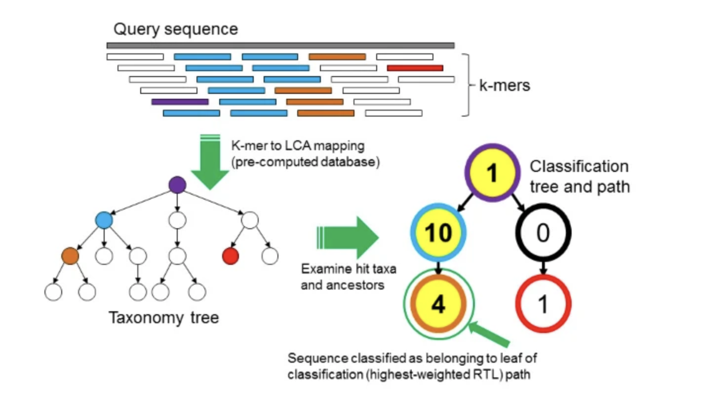
Sequence Classification Algorithm
Split input sequence in k-mers (31 base pairs)
Query pre-computed k-mer to LCA mapping database for an exact match.
If the input k-mer gets a hit, then the LCA will be part of a general taxonomy tree used for classification. If not, Kraken leaves the sequence unclassified.

Slide 6
Sequence Classification Algorithm (cont.)
Each node in the classification tree has a weight calculated by how many k-mers from the sequence matched with the node's taxon.
Now, calculate the root-to-leaf path in the classification tree by adding up the weights.
Highest-sum path contains the leaf that is the classification returned for the query sequence.

Slide 7
Comparing to Other Tools
Kraken vs. MegaBLAST, PhymmBL, NBC, MetaPhlAn
Tested on classification speed. genus-level sensitivity (# sequences classified correctly / total # sequences) and precision (# correct classifications / classifications attempted)
MegaBLAST – fastest BLAST algorithm and uses a greedy approach
PhymmBL – uses BLAST results combined with scoring from interpolated Markov models
Naïve Bayes Classifier (NBC) - uses Bayesian rule on predicting distributions of k-mers within a genome
MetPhlAn – an abundance estimation program that gives results for relative abundance of different taxa

Slide 8
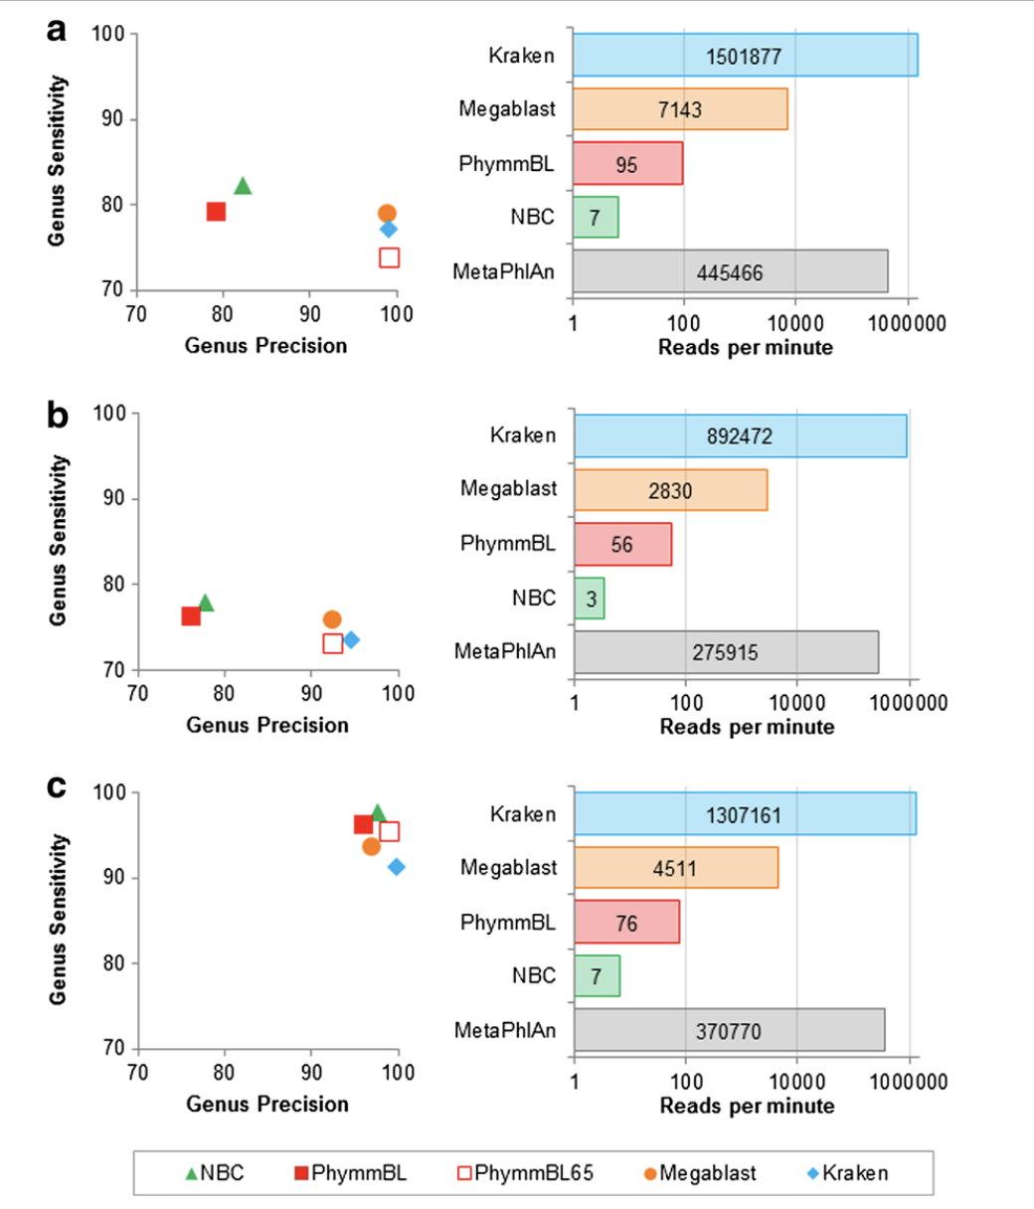
Comparing to Other Tools (Cont.)
Kraken 909x faster than MegaBLAST and 11x faster than MetaPhlAn.
Kraken has high precision and sensitivity.
Kraken wins in reads per minute by magnitudes.
Graph C uses a dataset that deleted data to simulate novel organisms in a sample.
Kraken is not as good at classifying novel sequences.

Slide 9
Classification
What is Kraken?
A metagenomic sequence classifier
exact alignment using k-mers
What makes it different from others (ex NBC)?
Leaves sequences unclassified if threshold is not reached
Notes:
Default k-mer value is 31

Slide 10
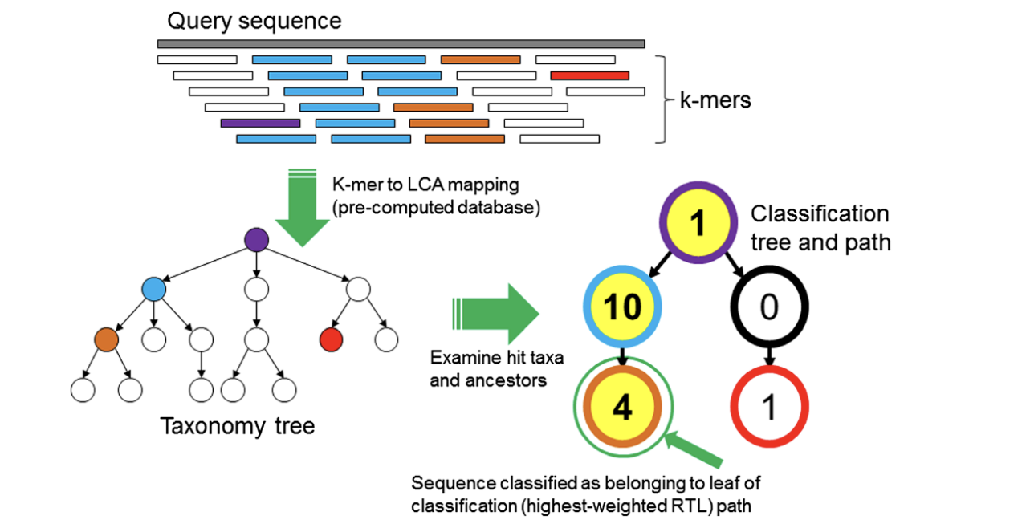

Classification Algorithm
From the initial sequence find all the possible k-mers
Map each k-mer to the lowest common ancestor (LCA) from all the genomic data, forming a classification tree
Each node is weighted based on the number of k-mers that associated to that taxonomy
Each root to leaf (RTL) path is calculated by summing all the weighted nodes in that branch.
The highest RTL is the classification path and is assigned to the initial sequence
Notes:
If there are multiple high scoring paths, the Lowest Common Ancestor of all those paths is chosen.
If no k-mers are found to match in the data base, the sequence is left unclassified.
If k-mers associate with taxa to far removed from each other, the sequence is left unclassified.

Slide 11
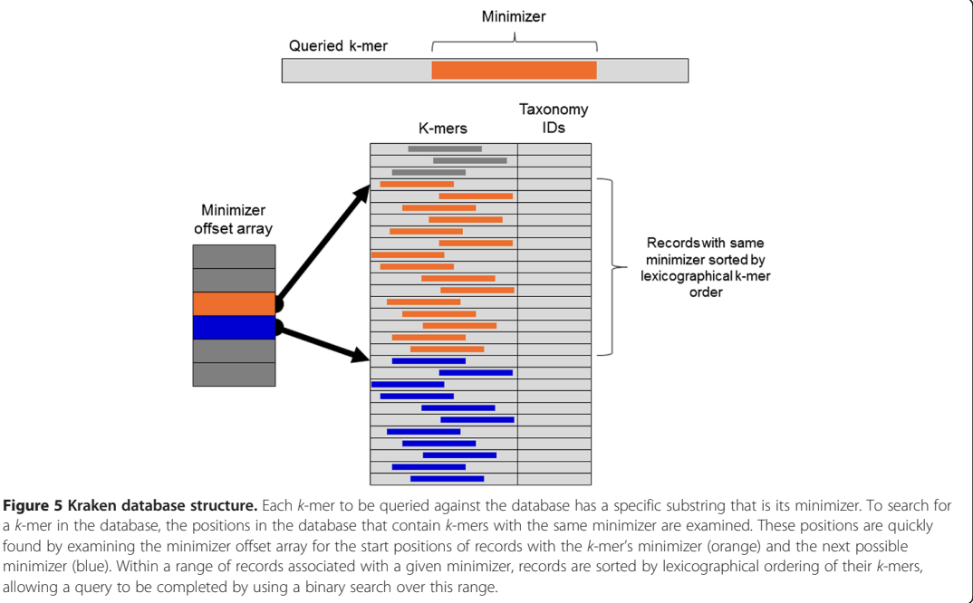
Databases
Default database ➔ completed microbial genomes from NCBI’s RefSeq database
Users can create there own
Pick a k-mer count
Find all sequences containing distinct k-mers and map to its taxonomic ID of the LCA
Searching database:
Notes:
NCBI = National Center for Biotechnology Information
Create your own database using “Jellyfish”
The picture represents the searching of the database: A minimizer for each k-mer is found, then the database finds the substring that is the minimizer, which then groups all the k-mers with that substring together

Slide 12
Designed for speed and accuracy
Previously used BLAST, MEGAN, PhymmBL, or Naïve Bayes ➔ computationally expensive and slow
Next attempt abundance estimation programs (MetaPhlAn) ➔ faster and less expensive but not as accurate
Kraken ➔ built for speed and accuracy
Notes:
PhymmBL ➔ Phymm, a classification approach using interpolated Markov models (IMMs) to taxonomically classify DNA sequences. PhymmBL (rhymes with "thimble"), the hybrid classifier included in this distribution which combines analysis from both Phymm and BLAST, produces even higher accuracy. https://www.cbcb.umd.edu/software/phymmbl/index.shtml
Abundance estimation programs ➔ instead of having whole database, use database of “marker genes” (single-copy genes present in nearly all microbes) or target genes that one is looking for
In a study done by Wood and Salzberg ➔ sensitivity was always within 2.5% of MegaBLAST, had highest precision of all in each case, and fastest (150 to 240 times faster than competitors)

Slide 13
Preparation
Start by logging in to Picotte
Download the needed database
wget https://genome-idx.s3.amazonaws.com/kraken/minikraken2_v2_8GB_201904.tgz
tar -xvzf minikraken2_v2_8GB_201904.tgz
Copy the FASTQ files
cd /ifs/groups/eces450650Grp/data/mappings
cp evol1.sorted.unmapped.R1.fastq /home/maw492
cp evol1.sorted.unmapped.R2.fastq /home/maw492
You can also use the –bind command instead when you start singularity

Slide 14
Container
Now you should be ready to run Kraken
Go to where the container is located
cd /ifs/groups/eces450650Grp/containers
Start Singularity
singularity run kraken2_latest.sif
Then run the kraken command
kraken2 --use-names --threads 4 --db PATH_TO_DB_DIR --report example.report.txt example.fa > example.kraken

Slide 15
Breaking down the options
How many threads you want to use
Container
kraken2 --use-names --threads 4
--db minikraken2_v2_8GB_201904_UPDATE
--report evol1
--paired evol1.sorted.unmapped.R1.fastq evol1.sorted.unmapped.R2.fastq > evol1.kraken
Selected Database
Summary Report
Files for classification
Classification Report

Slide 16
Outputs
First output:
Loading database information... done.
17692 sequences (0.85 Mbp) processed in 0.045s (23506.8 Kseq/m, 1125.36 Mbp/m).
768 sequences classified (4.34%)
16924 sequences unclassified (95.66%)
17692 sequences ➔ overall had 850,000 base pairs
Took a fraction of a second to run
Classified verse Unclassified percentages

Slide 17
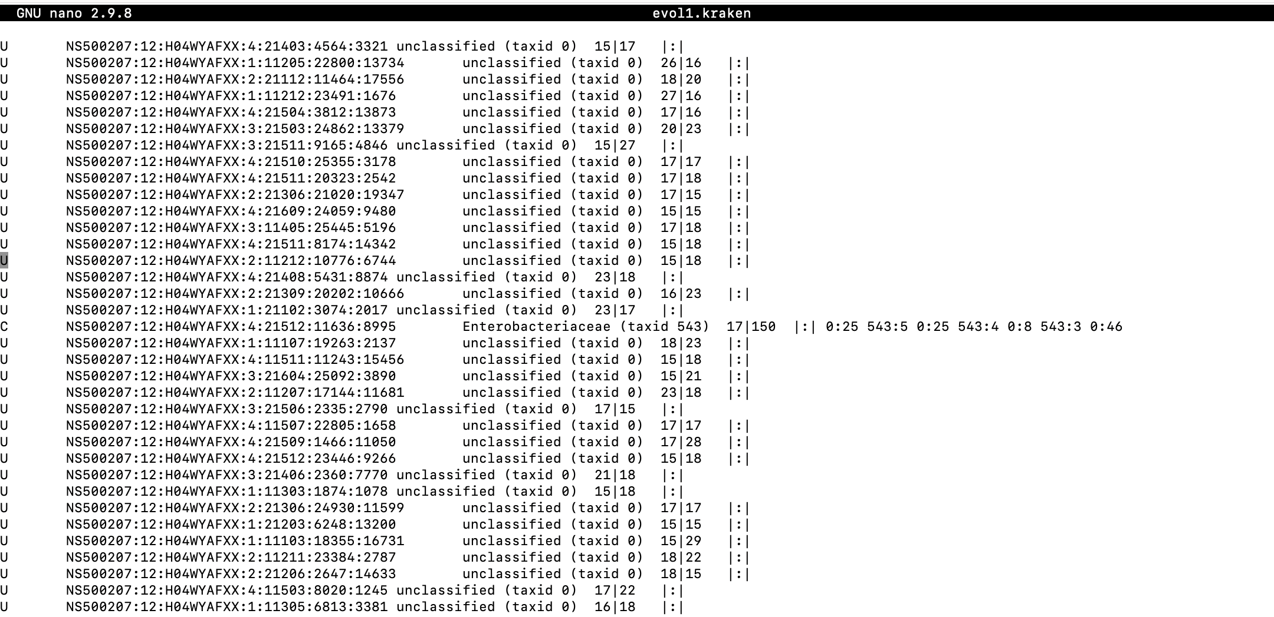
Outputs – Classification Report
U = unclassified or C = classified
Sequence ID from FASTQ
Taxonomy ID (NCBI taxid, 0 is unclassified)
Length of sequence in basepairs
|:| ➔ break before taxonomic tree list
First 25 k-mers mapped to ambiguous nucleotide
Next 5 mapped to taxonomy ID 543
Notes:
Since there are paired files file one is #| and file two is |#.

Slide 18
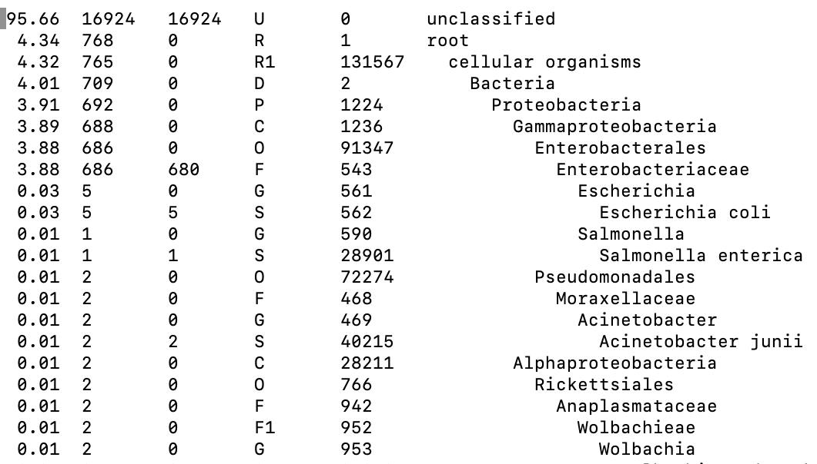
Outputs – Summary Report
Percentage of reads rooted to taxon
Number of reads rooted to taxon
Number of reads assigned directly to that taxon
Rank ➔ (U)nclassified, (D)omain, (K)ingdom…
NCBI Taxonomy ID
Scientific Name
Notes:
Also, could change report to report-zero-counts to print out all taxa not just those found.

Slide 19
Why know about Kraken?
Metagenomic projects produce huge amounts of data
Fast
Accurate
Fairly user friendly

Slide 20
Questions
Does the classification go up with a different database?
I don’t know, attempted with standard database
Cannot write to ‘k2_standard_20240112.tar.gz’ (No space left on device).

Slide 21
Resources
Tutorial Demo guide: https://genomics.readthedocs.io/en/latest/ngs-taxonomic-investigation/index.html#kraken2
Databases found at: https://github.com/BenLangmead/aws-indexes/blob/master/docs/k2.md
Read outs and Report help found at: (Good overview manual): https://github.com/DerrickWood/kraken2/blob/master/docs/MANUAL.markdown
About Kraken and Program comparisons:

